Slide 1
Paper Title: AUDRON: A Deep Learning Framework with Fused Acoustic Signatures for Drone Type Recognition
Authors: Rajdeep Chatterjee, Sudip Chakrabarty, Trishaani Acharjee, Deepanjali Mishra

Slide 2



Paper Outline
Introduction
Objective and Motivation
Literature Survey
AUDRON: The Core Idea
Experimental Setup
Results
Conclusion
References

Slide 3
Introduction (1/2)
Drones are now widely used across sectors such as delivery, agriculture, surveillance, and public safety. However, unauthorized drone activity poses significant security risks in sensitive areas including airports, stadiums, and military zones [1, 2].
Conventional detection systems face several challenges. Radar often fails to detect small, low-flying drones, while vision-based systems are limited by lighting, weather, and occlusions. Additionally, these systems are costly and require substantial infrastructure [3,4].

Slide 4
Introduction (2/2)
Limits of Existing Methods
Radar fails for small drones.
Cameras fail in bad light.
Infrared limited.
High cost.

Slide 5
Objective and Motivation
Objective:
To design an audio-based deep learning framework for reliable drone detection.
To fuse complementary acoustic features to improve detection accuracy and robustness.
To achieve high performance across both binary and multiclass drone detection tasks.
Motivation:
Unauthorized drone activity poses serious security threats in restricted and sensitive areas.
Radar and vision based detection systems struggle under real-world conditions and are costly to deploy.
Acoustic detection offers a low-cost alternative but requires robust modeling to handle noise and variability.

Slide 6
Literature Survey (1/3)
S. Al-Emadi, A. Al-Ali, A. Mohammad, and A. Al-Ali, “Audio based drone detection and identification using deep learning,” in 2019 15th International Wireless Communications & Mobile Computing Conference (IWCMC). IEEE, 2019, pp. 459–464. [5]
Proposed a deep learning framework using acoustic fingerprints extracted from recorded drone audio.
Demonstrated effective drone detection and identification using sound-only data.
Performance was strong in controlled settings but showed sensitivity to environmental noise.

Slide 7
Literature Survey (2/3)
I. Alla, H. B. Olou, V. Loscri, and M. Levorato, “From sound to sight: Audio-visual fusion and deep learning for drone detection,” in Proceedings of the 17th acm conference on security and privacy in wireless and mobile networks, 2024, pp. 123–133. [6]
Introduced an audio-visual fusion approach combining CRNN for audio and YOLOv5 for visual detection.
Achieved high detection accuracy by leveraging complementary modalities.
Reliance on both audio and visual inputs limits robustness when either modality is degraded.

Slide 8
Literature Survey (3/3)
M. Z. Anwar, Z. Kaleem, and A. Jamalipour, “Machine learning inspired sound-based amateur drone detection for public safety applications,” IEEE Transactions on Vehicular Technology, vol. 68, no. 3, pp. 2526-2534, 2019. [7]
Utilized MFCC and LPCC features with SVM classifiers for drone detection.
Achieved high accuracy on amateur drone sounds.
Performance degraded in noisy environments, highlighting limited real-world generalization.

Slide 9
AUDRON: The Core Idea
AUDRON (AUdio-based Drone Detection Network) processes a single raw audio waveform as input, without relying on visual or radar data.
The input audio is analyzed through four parallel feature extraction branches. Each branch captures complementary acoustic information, including spectral texture, time-frequency patterns, temporal dependencies, and compressed latent features.
These representations are fused at the feature level and jointly optimized.

Slide 10
AUDRON Model Architecture
AUDRON processes a single raw audio waveform using a multi-branch deep learning architecture.
The model integrates MFCC-based CNN, STFT-based CNN, BiLSTM with attention, and an audio autoencoder to capture complementary spectral, temporal, and latent features.
Feature level fusion enables robust discrimination between drone sounds and environmental noise.

Slide 11
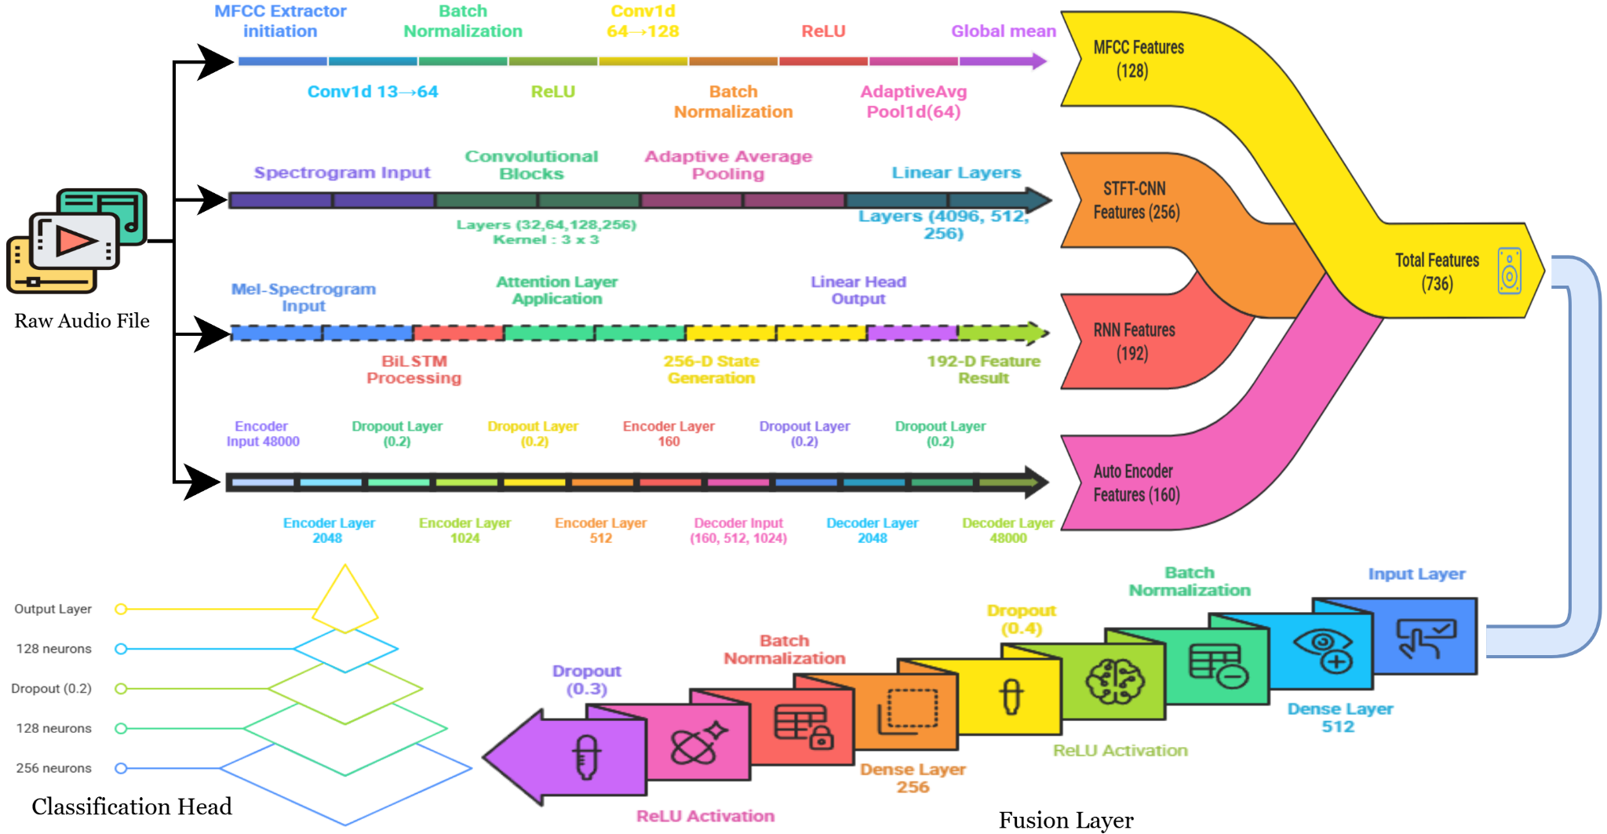
Fig 1: The complete architecture of the proposed multi-modal drone detection model, AUDRON.

Slide 12
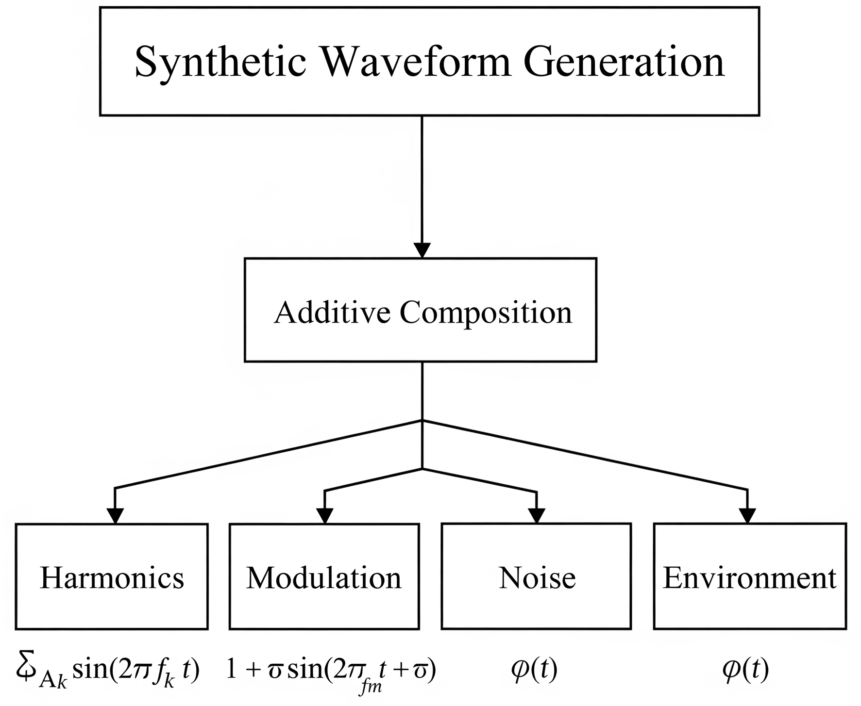
Experimental Setup (1/4)
Synthetic Audio Generation:
Synthetic drone waveforms are generated to improve model robustness.
Harmonics, modulation, noise, and environmental effects are combined to simulate realistic drone sounds.
This helps the model generalize across different drone types and conditions.
Fig. 2: Flowchart of synthetic audio generation highlighting key components used in the process.

Slide 13
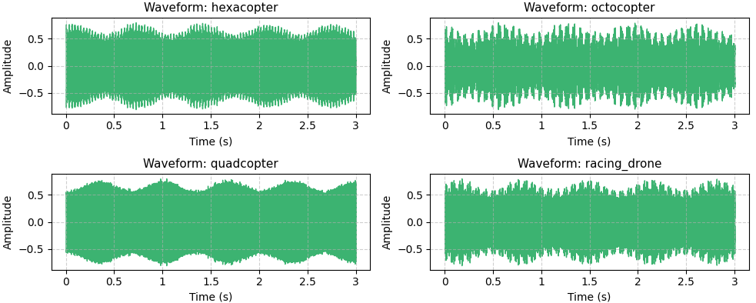
Experimental Setup (2/4)
Synthetic Waveform Examples:
Quadcopter
Hexacopter
Octocopter
Racing drone
Fig. 3: Sample waveforms from the synthetic model, illustrating distinct audio signatures for the four drone classes.

Slide 14
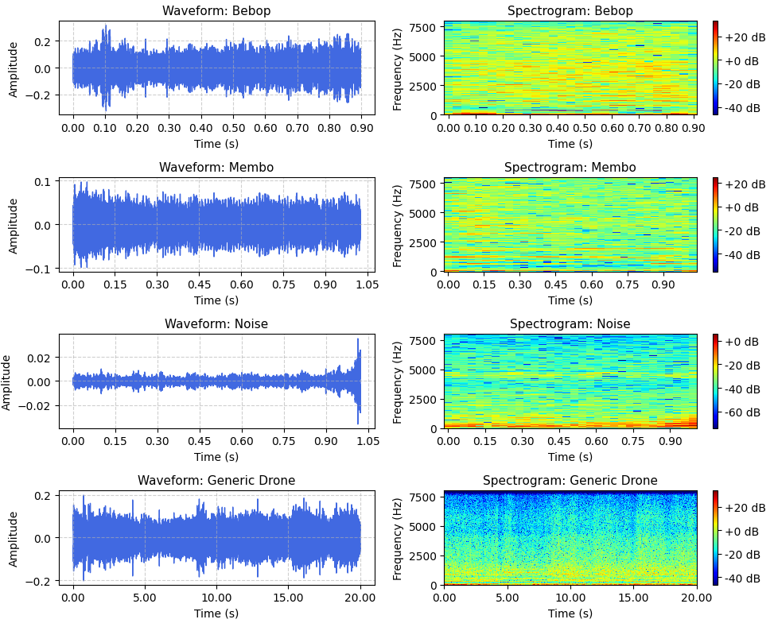
Experimental Setup (3/4)
Dataset Overview:
Real-world indoor drone audio from Bebop and Mambo platforms is used as the primary dataset [8,9].
Environmental and non-drone sounds from ESC-50, Speech Commands, and silence clips are incorporated to model background noise [10,11].
A supplementary drone dataset (175 samples) is added to enhance class diversity and improve generalization.
Fig. 4: Sample waveforms (left) and spectrograms (right) from the experimental datasets.

Slide 15
Experimental Setup (4/4)
Task | Split | Samples | Per-Class Distribution
Binary (No Augmentation) | Training Validation | 9,363 2,341 | 1,066 D, 8,297 N 266 D, 2,075 N
Binary (with Augmentation) | Training Validation | 9,502 2,376 | 1,205 D, 8,297 N 301 D, 2,075 N
Multiclass | Training Validation | 9,363 2,341 | 533 B, 533 M, 8,297 N 133 B, 133 M, 2,075 N
Multiclass (Synthetic Data) | Training Validation | 260 80 | 65 Q, 65 H, 65 O, 65 R 20 Q, 20 H, 20 O, 20 R
Model Training and Validation:
AdamW optimizer with an initial learning rate of 0.001 and ReduceLROnPlateau scheduling is employed [12,13].
The loss function combines cross-entropy loss for classification and weighted MSE for autoencoder reconstruction.
Early stopping and best-model checkpointing are used to prevent overfitting and ensure stable validation performance.
TABLE I: Detailed distribution of audio samples for each experimental setup. Abbreviations are: B (Bebop), D (Drone), M (Membo), N (Noise), Q (Quadcoptor), H (Hexacoptor), O (Octocoptor), R (Racing drone)

Slide 16
Feature Extraction Components
MFCC Branch: Extracts timbre-level spectral texture using 13 MFCCs followed by 1D CNN layers, producing a 128-D feature vector [14,15].
STFT-CNN Branch: Converts audio into time-frequency spectrograms and applies deep CNNs to learn discriminative spectro-temporal patterns.
RNN Branch: Uses BiLSTM with attention to model temporal dependencies and long-term rotor dynamics.
Autoencoder Branch: Learns compact latent embeddings that encode global waveform structure.

Slide 17
Results (1/7)
AUDRON demonstrates strong performance across synthetic, binary, and multiclass classification tasks.
On synthetic drone audio, the model achieves 99.92% accuracy, validating its effectiveness on clean and controlled signals.
For real-world binary classification (drone vs non-drone), AUDRON achieves a peak accuracy of 98.51% with an F1-score of 0.9837.
In the multiclass classification task, the model maintains high accuracy of 97.11%, indicating robust class discrimination.

Slide 18
Results (2/7)
Task / Data Configuration | Accuracy (%) | Precision | Recall | F1-Score | Training Time (min)
Synthetic Data | 99.92 ± 0.05 | 0.9990 ± 0.08 | 0.9995 ± 0.04 | 0.9989 ± 0.08 | 74
Binary Classification (No Augmentation) | 98.51 ± 0.09 | 0.9842 ± 0.11 | 0.9840 ± 0.10 | 0.9837 ± 0.12 | 235
Binary Classification (With Augmentation) | 97.98 ± 0.18 | 0.9802 ± 0.20 | 0.9799 ± 0.19 | 0.9799 ± 0.21 | 310
Multiclass Classification | 97.11 ± 0.25 | 0.9689 ± 0.28 | 0.9697 ± 0.26 | 0.9686 ± 0.07 | 293
TABLE II: Model performance across different datasets and classification tasks.

Slide 19
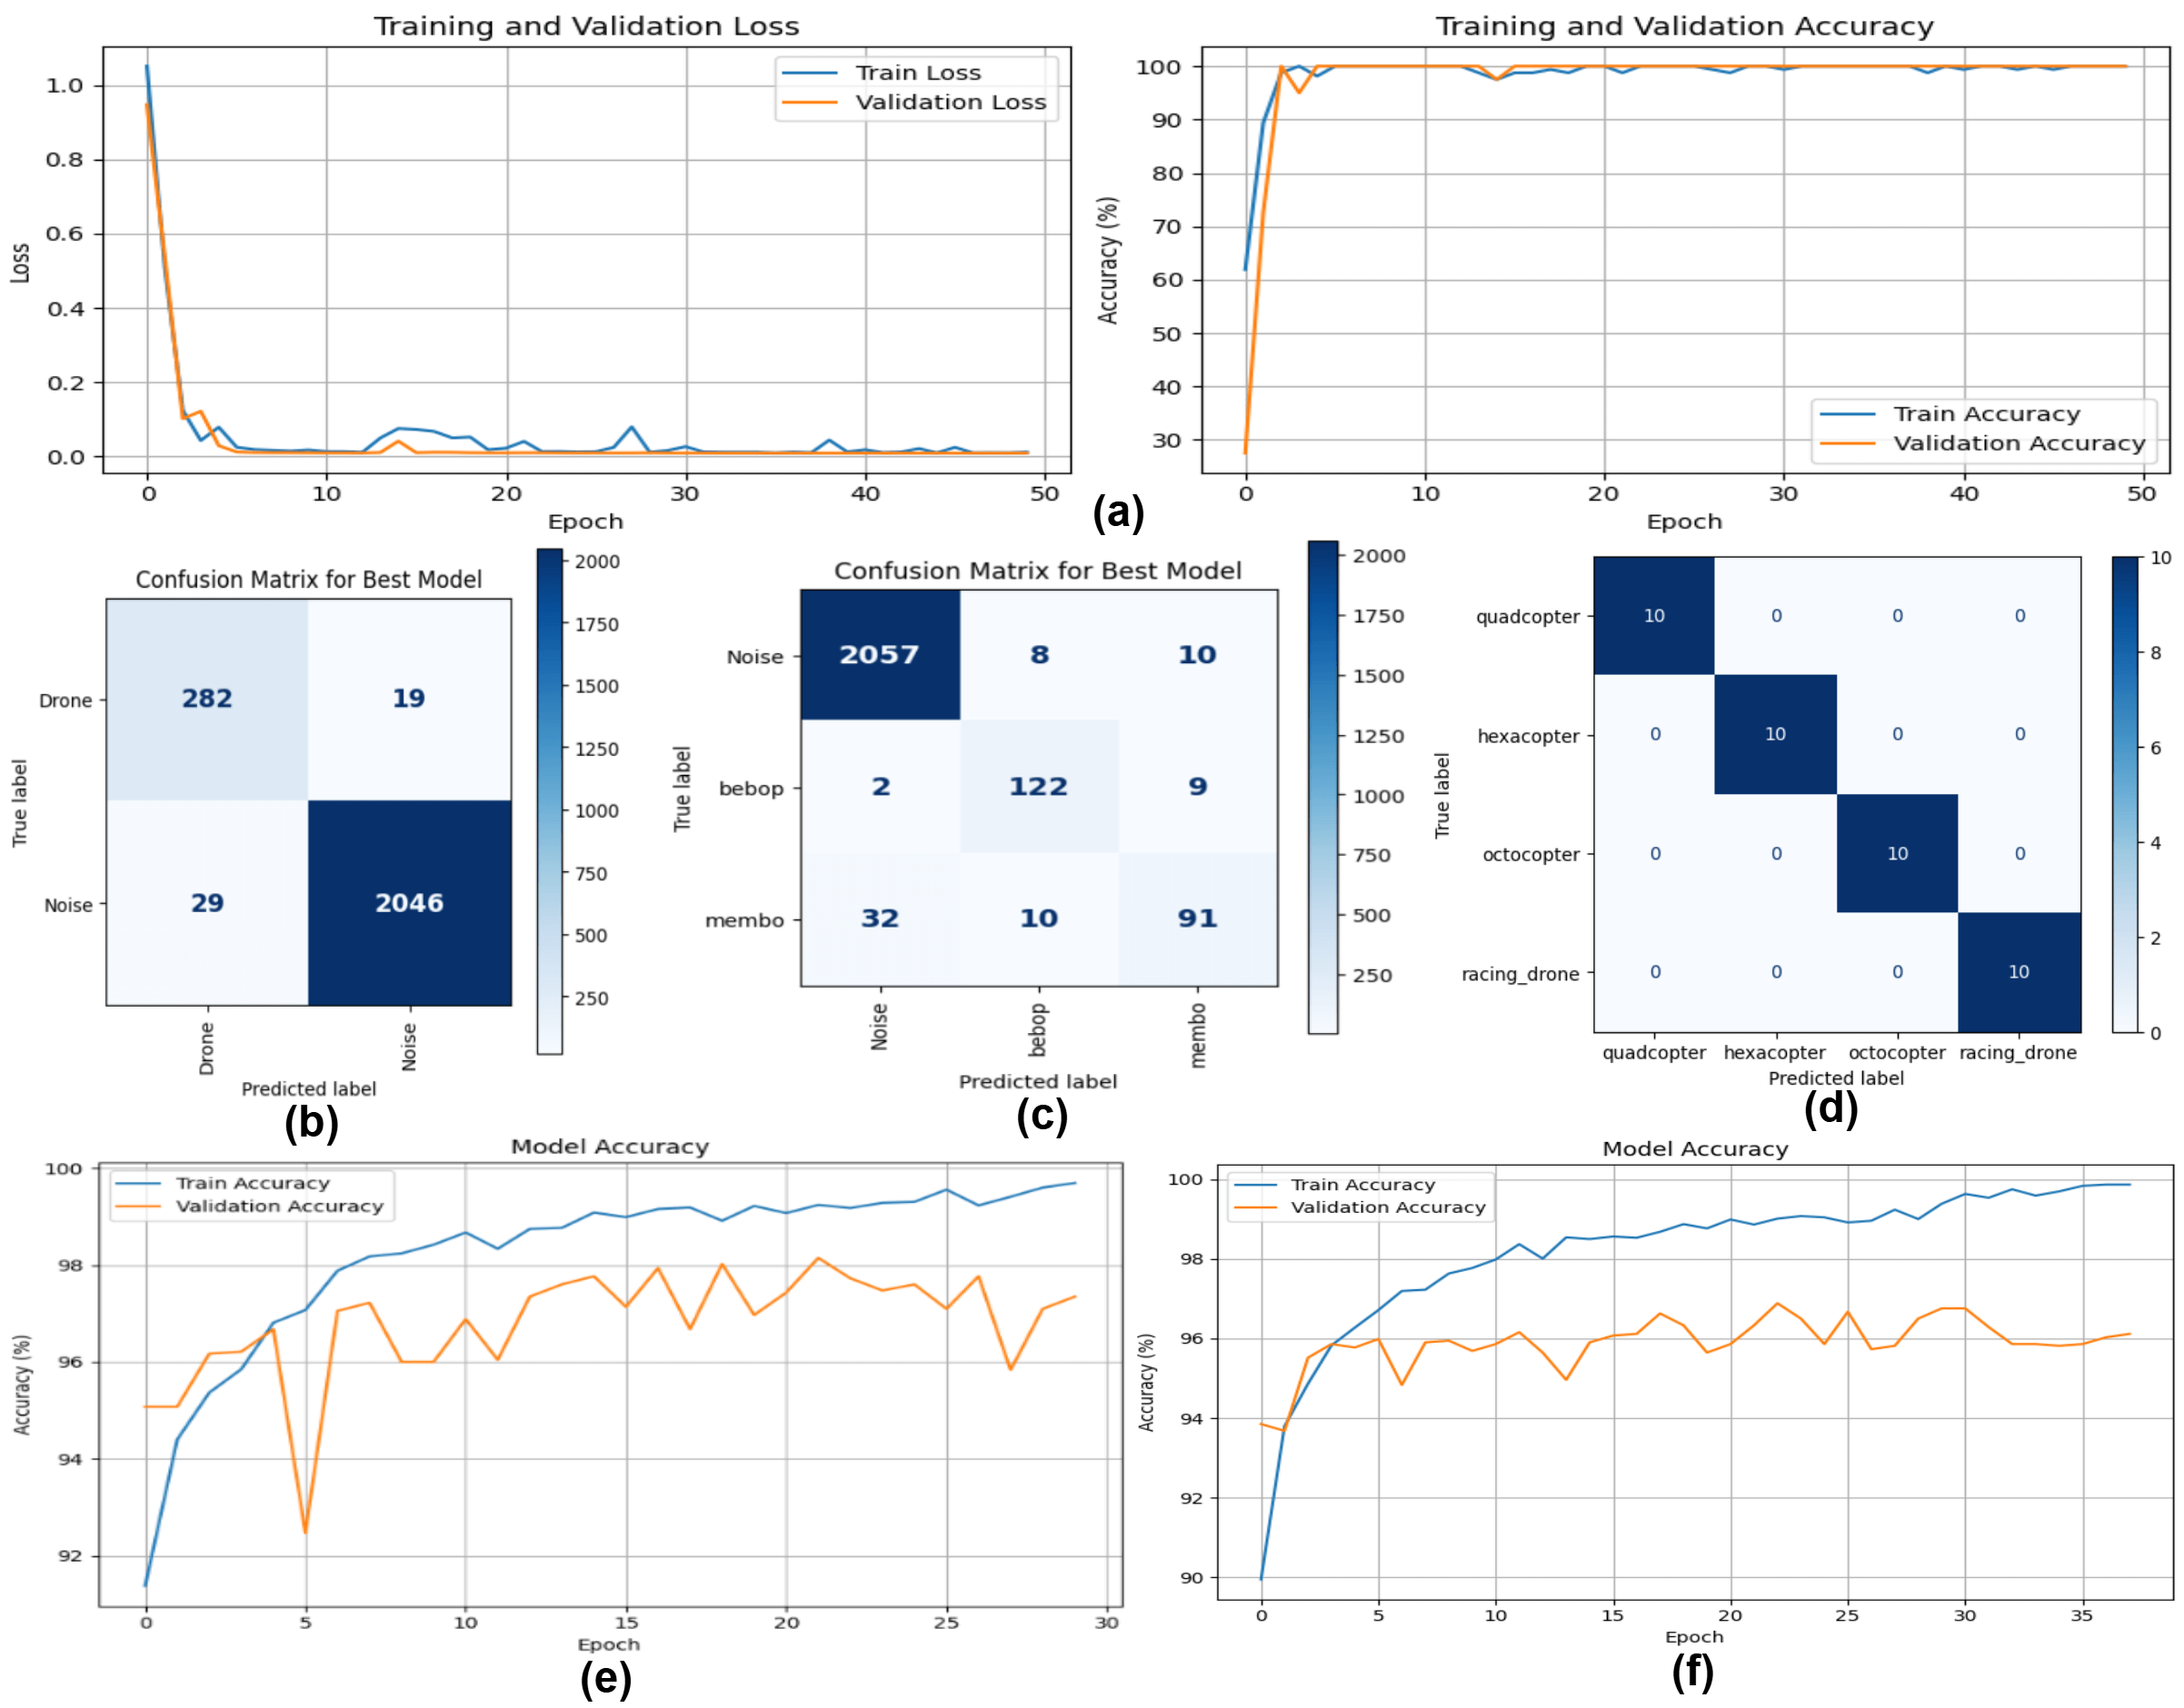
Results (3/7)
Fig 5: Training dynamics and performance evaluation of the proposed model across different datasets and tasks.

Slide 20
Results (4/7)
Training and validation curves show rapid convergence, with high accuracy achieved within the initial epochs.
Validation performance closely follows training performance, indicating effective regularization and minimal overfitting.
Confusion matrices reveal strong diagonal dominance, confirming low misclassification rates across binary, multiclass, and synthetic datasets.
The model consistently identifies drone instances with high precision while minimizing false positives from noise classes.

Slide 21
Results (5/7)
ABLATION STUDY RESULTS
Removing the MFCC branch results in the largest performance drop (≈4.7%), underscoring its importance in capturing spectral texture.
Excluding the STFT-CNN or RNN branches causes moderate accuracy degradation, confirming their role in learning spectro-temporal and sequential patterns.
The autoencoder branch provides additional performance gains by enriching latent feature representations.
The full model with all four branches achieves the highest accuracy of 98.51%.

Slide 22
Results (6/7)
ABLATION STUDY RESULTS
Model Configuration | Accuracy (%) | Precision | Recall | F1-Score | Performance Drop (%)
STFT-CNN + RNN + Autoencoder | 93.81 ± 0.31 | 0.9321 ± 0.24 | 0.9334 ± 0.25 | 0.9333 ± 0.22 | 4.70
MFCC + RNN + Autoencoder | 97.38 ± 0.19 | 0.9740 ± 0.21 | 0.9714 ± 0.18 | 0.9352 ± 0.20 | 1.13
MFCC + STFT-CNN + Autoencoder | 97.61 ± 0.15 | 0.9755 ± 0.19 | 0.9761 ± 0.17 | 0.9757 ± 0.16 | 0.90
MFCC + STFT-CNN + RNN | 97.92 ± 0.12 | 0.9787 ± 0.16 | 0.9791 ± 0.14 | 0.9792 ± 0.13 | 0.59
MFCC + STFT + RNN + Autoencoder (Full Model) | 98.51 ± 0.09 | 0.9842 ± 0.11 | 0.9840 ± 0.10 | 0.9837 ± 0.12 | ---
TABLE III: Ablation study results showing model performance with different feature combinations.

Slide 23
Results (7/7)
AUDRON v/s S-O-T-A
AUDRON consistently outperforms baseline CNN, RNN, and CRNN architectures across both binary and multiclass tasks.
In binary classification, AUDRON surpasses the best baseline CNN by over 2% accuracy.
In multiclass classification, AUDRON improves accuracy by more than 4% compared to the strongest baseline.
Classification Task | Model | Accuracy (%) | F1-Score (%)
Binary | CNN | 96.38 ± 0.69 | 95.90 ± 0.78
Binary | RNN | 75.00 ± 6.60 | 68.38 ± 8.16
Binary | CRNN | 94.72 ± 1.36 | 93.93 ± 1.61
Binary | AUDRON | 98.51 ± 0.09 | 98.37 ± 12.00
Multiclass | CNN | 92.94 ± 11.89 | 92.63 ± 1.32
Multiclass | RNN | 57.16 ± 11.33 | 55.62 ± 13.53
Multiclass | CRNN | 92.22 ± 1.03 | 92.25 ± 1.01
Multiclass | AUDRON | 97.11 ± 0.251 | 96.71 ± 7.013
TABLE IV: Performance comparison of the proposed model against baseline architectures without data augmentation.

Slide 24
Conclusion
AUDRON demonstrates effective audio-based drone detection using a multi-branch deep learning architecture.
Feature-level fusion enables robust performance, achieving 98.51% accuracy on real-world data.
The results confirm the potential of acoustic sensing for reliable drone detection in challenging environments.

Slide 25
References
[1] M. Tahir, M. Aamir, S. A. Rajper, and R. Kumar, “Future implications of the drone industry: Emerging trends and potential challenges,” Computer Vision and Edge Computing Technologies for the Drone Industry, pp. 167–182, 2025.
[2] A. Jackman, “Everyday understandings of drone incidents and misuse in the mass observation archive,” The Geographical Journal, vol. 191, no. 2, p. e12618, 2025.
[3] P. Chen, X. Zhao, L. Zeng, L. Liu, S. Liu, L. Sun, Z. Li, H. Chen, G. Liu, Z. Qiao et al., “A review of research on slam technology based on the fusion of lidar and vision,” Sensors, vol. 25, no. 5, p. 1447, 2025.
[4] S. Chakrabarty, R. Chatterjee, S. Chakraborty, S. Roy Shuvo, and R. Chowdhury, “Drones in defense: Real-time vision-based military target surveillance and tracking,” in 2025 3rd International Conference on Intelligent Systems, Advanced Computing and Communication (ISACC), 2025, pp. 508–513.
[5] S. Al-Emadi, A. Al-Ali, A. Mohammad, and A. Al-Ali, “Audio based drone detection and identification using deep learning,” in 2019 15th International Wireless Communications & Mobile Computing Conference (IWCMC). IEEE, 2019, pp. 459–464.
[6] I. Alla, H. B. Olou, V. Loscri, and M. Levorato, “From sound to sight: Audio-visual fusion and deep learning for drone detection,” in Proceedings of the 17th acm conference on security and privacy in wireless and mobile networks, 2024, pp. 123–133.
[7] M. Z. Anwar, Z. Kaleem, and A. Jamalipour, “Machine learning inspired sound-based amateur drone detection for public safety applications,”IEEE Transactions on Vehicular Technology, vol. 68, no. 3, pp. 2526 -2534, 2019.
[8] Al-Emadi, S., Al-Ali, A., Mohammad, A., & Al-Ali, A. (2019, June). Audio based drone detection and identification using deep learning. In 2019 15th International Wireless Communications & Mobile Computing Conference (IWCMC) (pp. 459-464). IEEE.

Slide 26
References
[9] C. R. Romero, A. J. T. Martinez, N. Green, and C. Asensio, “DroneNoise Database,” 2 2023. [Online]. Available: https://salford.figshare.com/articles/dataset/DroneNoise Database/22133411.
[10] N. Kamarudin, S. A. R. Al-Haddad, A. Khmag, A. Hassan, and S. Hashim, “Analysis on mel frequency cepstral coefficients and linear predictive cepstral coefficients as feature extraction on automatic accents identification,” International Journal of Applied Engineering Research, vol. 11, pp. 7301–7307, 06 2016.
[11] Q. Dong, Y. Liu, and X. Liu, “Drone sound detection system based on feature result-level fusion using deep learning,” Multimedia Tools and Applications, vol. 82, no. 1, pp. 149–171, 2023.
[12] E. Akbal, A. Akbal, S. Dogan, and T. Tuncer, “An automated accurate sound-based amateur drone detection method based on skinny pattern,” Digital Signal Processing, vol. 136, p. 104012, 2023. [Online]. Available: https://www.sciencedirect.com/science/article/pii/S1051200423001070
[13] H. Lei, R. Gadgil, S. K. Amgothu, and D. Kar, “Uav audio detection and identification using short-time fourier transform spectrograms with deep learning models,” in 2025 International Conference on UnmannedAircraft Systems (ICUAS), 2025, pp. 1043–1048.
[14] R. Chatterjee, P. Bishwas, S. Chakrabarty, and T. Bandyopadhyay, “South asian sounds: Audio classification,” in 2024 4th International Conference on Computer, Communication, Control & Information Technology (C3IT), 2024, pp. 1–6.
[15] K. J. Piczak, “Esc: Dataset for environmental sound classification,” in Proceedings of the 23rd ACM international conference on Multimedia, 2015, pp. 1015–1018.

Slide 27


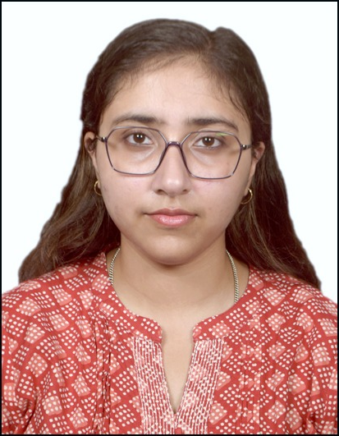

THANK YOU
Rajdeep Chatterjee
Associate Professor
Sudip Chakrabarty
Student
Trishaani Acharjee
PhD Scholar
Deepanjali Mishra
Associate Professor

